Slide 1
Modeling a D flipflop in Verilog
Outputs of this sequential storage device are not updated continuously; its behaviour is modeled using a procedural assignment. (Non-blocking assignments)
In the sensitivity list,
C input controls when the D-Latch is in track or store mode.
D input in the sensitivity list because during the track mode, the output Q will be assigned the value of D so any change on D needs to trigger the proceduralassignments.
The use of an if-else statement is used to model the behavior during track mode (C = 1)
Since the behavior is not explicitly stated for when C = 0, the outputs will hold their last value, which allows us to simply omit the else portion of the if statement to complete the model.

Slide 2
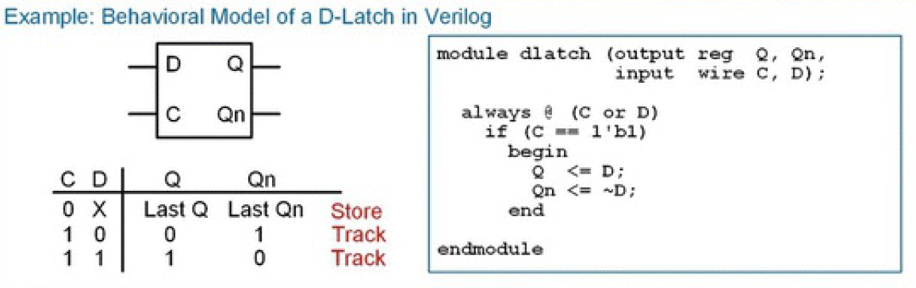

Slide 3
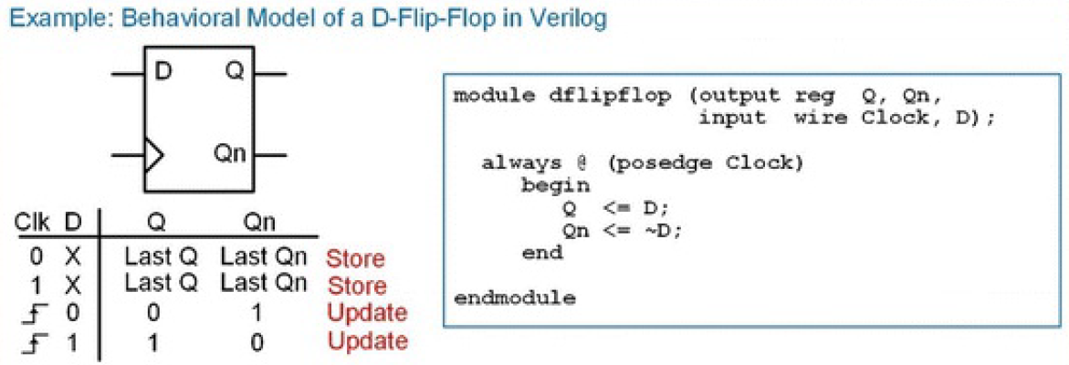

Slide 4
D-Flip-Flop with Asynchronous Reset
D-Flip-Flops typically have a reset line to initialise their outputs to known states (e.g., Q = 0, Qn = 1).
Resets are asynchronous, meaning whenever they are asserted, assignments to the outputs take place immediately.
If a reset was synchronous, the outputs would only update on the next rising edge of the clock. This behavior is undesirable because if there is a system failure, there is no guarantee that a clock edge will ever occur. Thus, the reset may never take place.
Asynchronous resets are more desirable not only to put the D-Flip-Flops into a known state at startup, but also to recover from a system failure that may have impacted the clock signal. In order to model this asynchronous behavior, the reset signal is included in the sensitivity list. This allows both clock and the reset transitions to trigger the procedural block.

Slide 5
D-Flip-Flop with Asynchronous Reset
The edge sensitivity of the reset can be specified using posedge (active HIGH) or negedge (active LOW).
Within the block an if-else statement is used to determine whether the reset has been asserted or a rising edge of the clock has occurred.
The ifelse statement first checks whether the reset input has been asserted since it has the highest priority. If it has, it makes the appropriate assignments to the outputs (Q = 0, Qn = 1).
If the reset has not been asserted, the else clause is executed, which corresponds to a rising edge of clock (Q < = D, Qn < = ~ D).
No other assignments are listed in the block, thus the outputs are only updated on a transition of the reset or clock.
At all other times the outputs remain at their current value, thus modeling the store behavior of the D-Flip-Flop.

Slide 6
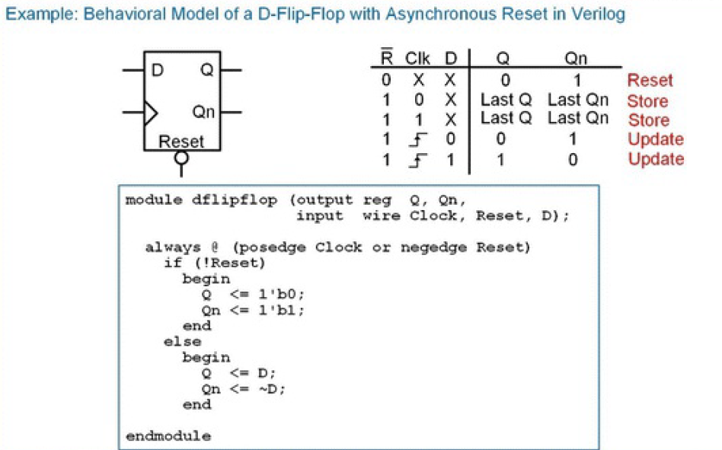

Slide 7
D-Flip-Flop with Asynchronous Reset and Preset
The preset input is included in the sensitivity list to trigger the block whenever a transition occurs on either the clock, reset, or preset inputs.
The edge sensitivity keywords are used to dictate whether the preset is active HIGH or LOW.
Nested if-else statements are used to first check whether a reset has occurred; then whether a preset has occurred; and finally, whether a rising edge of the clock has occurred.

Slide 8
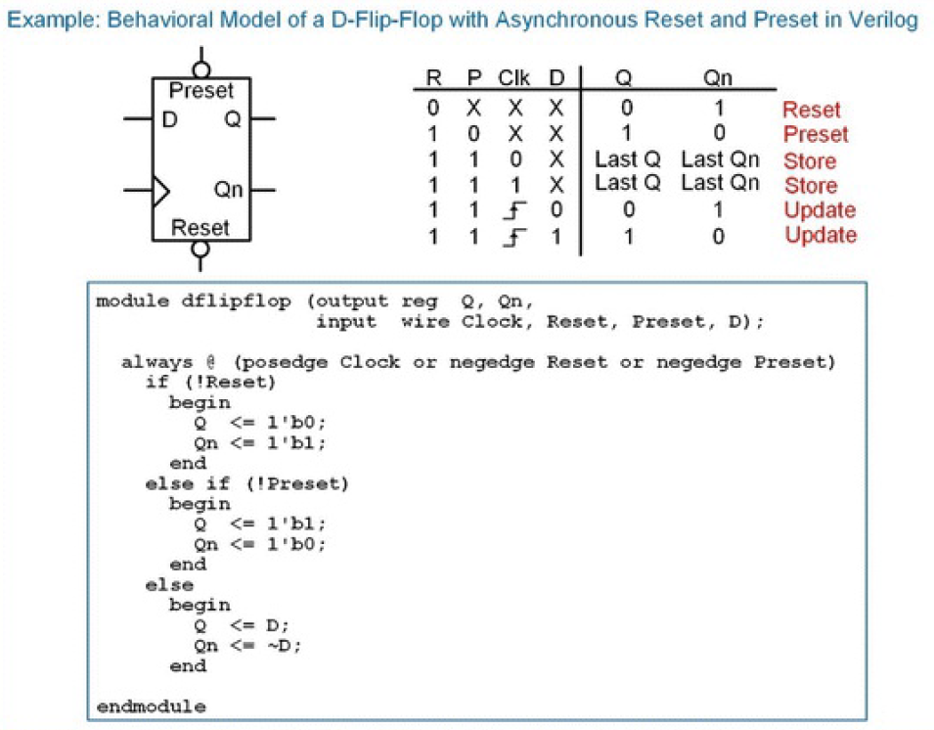

Slide 9
D-Flip-Flop with Synchronous Enable
An enable input is also a common feature of modern D-Flip-Flops.
Enable inputs are synchronous, meaning that when they are asserted, action is only taken on the rising edge of the clock. This means that the enable input is not included in the sensitivity list of the always block.
Since enable is only considered when there is a rising edge of the clock, the logic for the enable is handled in a nested if-else statement that is included in the section that models the behavior for when a rising edge of clock is detected.

Slide 10
D-Flip-Flop with Synchronous Enable
Model for a D-Flip-Flop with a synchronous enable (EN) input.
When EN = 1, the D-Flip-Flop is enabled and assignments are made to the outputs only on the rising edge of the clock.
When EN = 0, the D-Flip-Flop is disabled and assignments to the outputs are not made.
When disabled, the D-Flip-Flop effectively ignores rising edges on the clock and the outputs remain at their last values.

Slide 11
